Slide 1

“Book Recommendation System”
TERNA ENGINEERING COLLEGE
DEPARTMENT OF COPUTER ENGINEERING
BE/SEM-VII
Anjali Shinde. [C-22] Student ID –TU3F2122159
Harsh Minde. [C-28] Student ID -TU3F2122164
Rushikesh Jadhav. [C-31] Student ID -TU3F2122167
Under the guidance of
Dr. Siddharth Hariharan.
Academic Year
2024-25

Slide 2
CONTENT
Introduction
Problem Statement
Objective
Scope Of The Project
Software & hardware Requirement
Software Design
Algorithm & Method Used
Project Implementation
Conclusion
Reference

Slide 3
1. Introduction
As the digital age progresses, the sheer volume of content available to users - books, music, movies has grown exponentially. Consequently, recommendation systems have become a critical aspect of web applications, assisting users in finding the most relevant and personalized content.
The Book Recommendation System is designed to simplify the process of book discovery by providing personalized recommendations to users based on their past interactions or the popularity of books within the system. This project focuses on using Natural Language Processing (NLP) techniques in conjunction with machine learning algorithms to create a highly effective recommendation model.

Slide 4
2. Problem Statement
Readers often find it difficult to select new books due to the overwhelming volume of choices available. This project addresses the challenge by implementing a Book Recommendation System that employs two main strategies:
Popularity-Based Recommendations: Highlights top-rated books based on user feedback.
Collaborative Filtering: Recommends books based on a user’s interaction with other similar books and the preferences of other users.

Slide 5
3. Objective
The main objective of this project is to:
Develop a web-based system that allows users to search for books and receive personalized recommendations.
Implement two different recommendation techniques popularity-based and collaborative filtering to cater to different user preferences.
Create a user-friendly Graphical User Interface (GUI) that displays the top 50 books and provides recommendations in real-time.

Slide 6
4. Scope Of The Project
This project is designed as a scalable web application capable of handling a growing user base and
dataset. The system supports both popularity-based and personalized recommendations using
collaborative filtering techniques. It is built using Flask for the backend, Bootstrap for the frontend,
and Python libraries for machine learning.

Slide 7
5. Software & hardware Requirement
1. Operating System: Windows 10/11 or Linux (Ubuntu 20.04 or above).
2. Programming Language: Python 3.x (latest version recommended).
3. Integrated Development Environment (IDE): Visual Studio Code or PyCharm.
4. Web Framework: Flask (micro web framework written in Python).
5. Libraries Used: 5.1 Flask: To manage the web server and routing.
5.2 Numpy: For handling arrays and mathematical operations. 5.3 Pandas: For managing and processing data in tabular form. 5.4 Pickle: For serializing and de-serializing Python objects (used to store the model). 5.5 Scikit-learn: For implementing the machine learning algorithms (Collaborative Filtering).
6. Frontend Technologies: HTML5, CSS3, Bootstrap 3.3.7.
7. Databases: CSV files containing books, users, and ratings data.

Slide 8
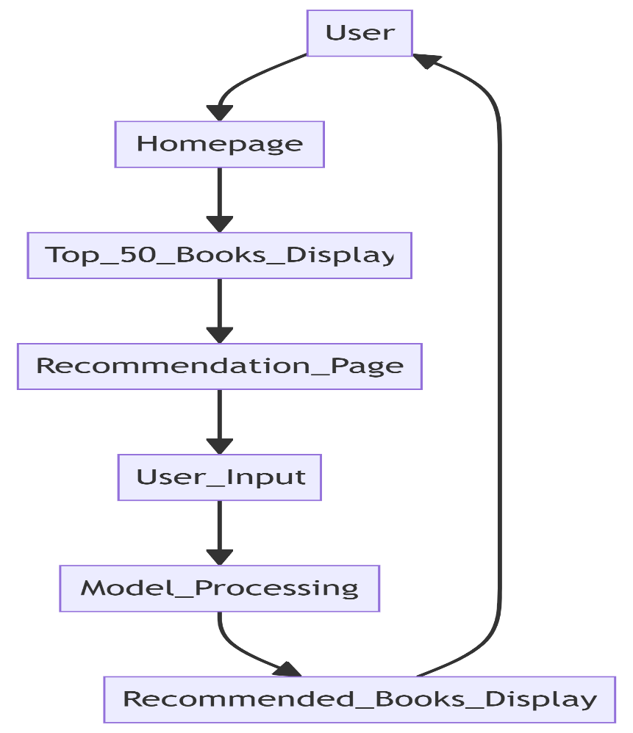
6. Software Design
Fig: 6.1

Slide 9
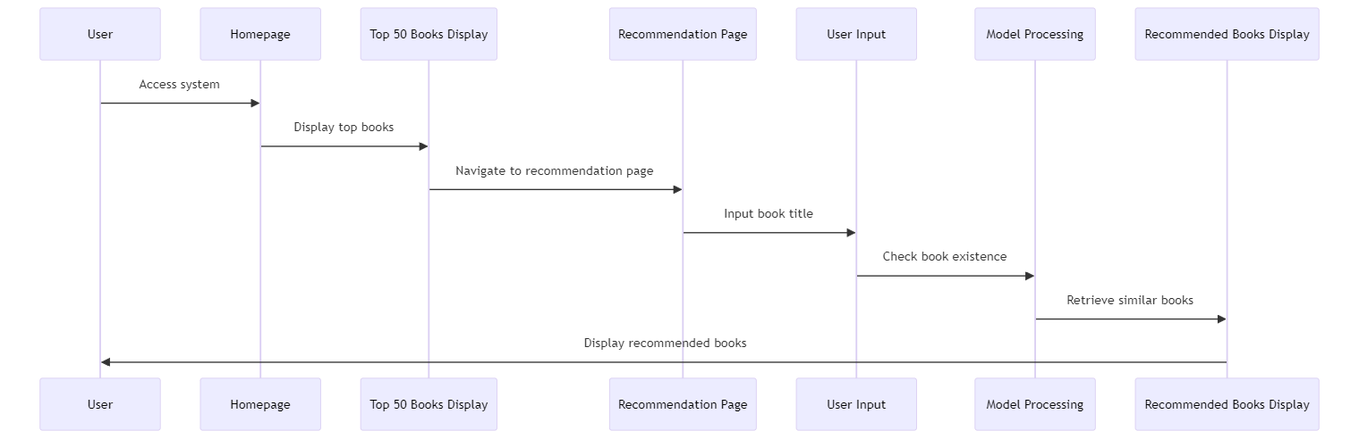
6. Software Design
Fig: 6.2

Slide 10
7. Algorithm & Method Used
7.1 Popularity-Based Recommender System:
This method ranks books based on their popularity metrics, specifically the number of ratings and the average rating for each book. The implementation follows these steps:
Data Aggregation: Ratings data is aggregated to count the number of ratings and calculate the average rating for each book.
Filtering: Only books with a minimum of 250 ratings are considered.
Top 50 Selection: The books are then sorted based on their average rating, and the top 50 books are selected for display.

Slide 11
7. Algorithm & Method Used
7.1 Popularity-Based Recommender System:
Algorithmic Flow:
Aggregate rating data.
Filter out books with fewer than 250 ratings.
Sort books by average rating.
Select the top 50 books for display.

Slide 12
7. Algorithm & Method Used
7.2 Collaborative Filtering Based Recommender System:
Collaborative filtering is a method used to recommend items (books) to a user by finding similarities between items based on user ratings. The cosine similarity method is used to calculate the similarity between books based on user ratings.
Steps in Collaborative Filtering:
Pivot Table Creation: A pivot table is created where rows represent book titles, columns represent user IDs, and cells contain the rating a user has given to a book.
Cosine Similarity Calculation: Using the cosine similarity metric, the similarity between books is calculated.
Recommendation Retrieval: When a user inputs a book, the system identifies similar books based on their similarity scores and presents them as recommendations.

Slide 13
7. Algorithm & Method Used
7.2 Collaborative Filtering Based Recommender System:
Algorithmic Flow:
Create a pivot table using books and users.
Compute cosine similarity between books.
Identify top similar books based on the input book.
Present recommendations.

Slide 14
8. Project Implementation
8.1 Data Collection and Preprocessing:
Datasets Used:
Books Dataset: Contains details about books including title, author, and image URL.
Users Dataset: Contains information about users, primarily used for collaborative filtering.
Ratings Dataset: Contains user ratings for different books. This dataset forms the basis for both the popularity-based and collaborative filtering models.
Preprocessing Steps:
Data Cleaning: Handle missing values and remove any duplicates in the data.
Merging Datasets: Combine the books and ratings data into a single dataset that can be used for modeling.
Data Splitting: Split the data into training and test sets for evaluation (optional if further model training is needed).

Slide 15
8. Project Implementation
8.2 Model Training and Serialization:
The models are trained using the preprocessed datasets:
Popularity Model: This model is trained by calculating the number of ratings and the average rating for each book. The top 50 books are then serialized using Pickle for fast access during runtime.
Collaborative Filtering Model: The pivot table is created, and cosine similarity scores are calculated for every book. The similarity matrix is then serialized for efficient retrieval of recommendations.
Pickle Files:
popular.pkl: Contains the top 50 popular books.
similarity_scores.pkl: Stores the cosine similarity scores between books.
pt.pkl: Contains the pivot table used for collaborative filtering.

Slide 16
8. Project Implementation
8.3 Flask Application:
The Flask App serves as the backbone of the web application, handling user interactions and routing requests:
Homepage Route (/): Displays the top 50 books using the popularity-based model.
Recommendation Page Route (/recommend): Handles the input of book names and retrieves recommendations from the collaborative filtering model.

Slide 17
9. Conclusion
The Book Recommendation System successfully implements a two-fold recommendation strategy
that includes both popularity-based and collaborative filtering techniques. The system provides
users with a simple and intuitive interface that enables them to discover popular books or find
recommendations based on their specific input.
By leveraging Natural Language Processing (NLP) and machine learning techniques, this project
demonstrates the power of recommendation systems in improving user experience on web platforms.
The use of Flask for web application development and Python for machine learning provides a
robust, scalable solution that can be extended with additional features such as user profiles, real-time
recommendations, and personalized recommendation models.

Slide 18
10. Reference
Kaggle
Youtube

Slide 19


